Slide 1

American Association of Clinical Endocrinology Consensus Statement: Comprehensive Type 2 Diabetes Management Algorithm – 2023 Update
Susan L. Samson, MD, PhD, FRCPC, FACE, Priyathama Vellanki, MD, Lawrence Blonde, MD, FACP, MACE, Elena A. Christofides, MD, FACE, Rodolfo J. Galindo, MD, FACE, Irl B. Hirsch, MD, Scott D. Isaacs, MD, FACP, FACE, Kenneth E. Izuora, MD, MBA, FACE, Cecilia C. Low Wang, MD, FACP, Christine L. Twining, MD, FACE, Guillermo E. Umpierrez, MD, CDCES, MACP, FACE, Willy Marcos Valencia, MD, MSc
Endocrine Practice
Volume 29 Issue 5 Pages 305-340 (May 2023)
DOI: 10.1016/j.eprac.2023.02.001
Copyright © 2023 AACE Terms and Conditions

Slide 2

Endocrine Practice 2023 29305-340DOI: (10.1016/j.eprac.2023.02.001)
Copyright © 2023 AACE Terms and Conditions
Notes:
2023 AACE Type 2 Diabetes Algorithm Title Page. AACE = American Association of Endocrinology.

Slide 3
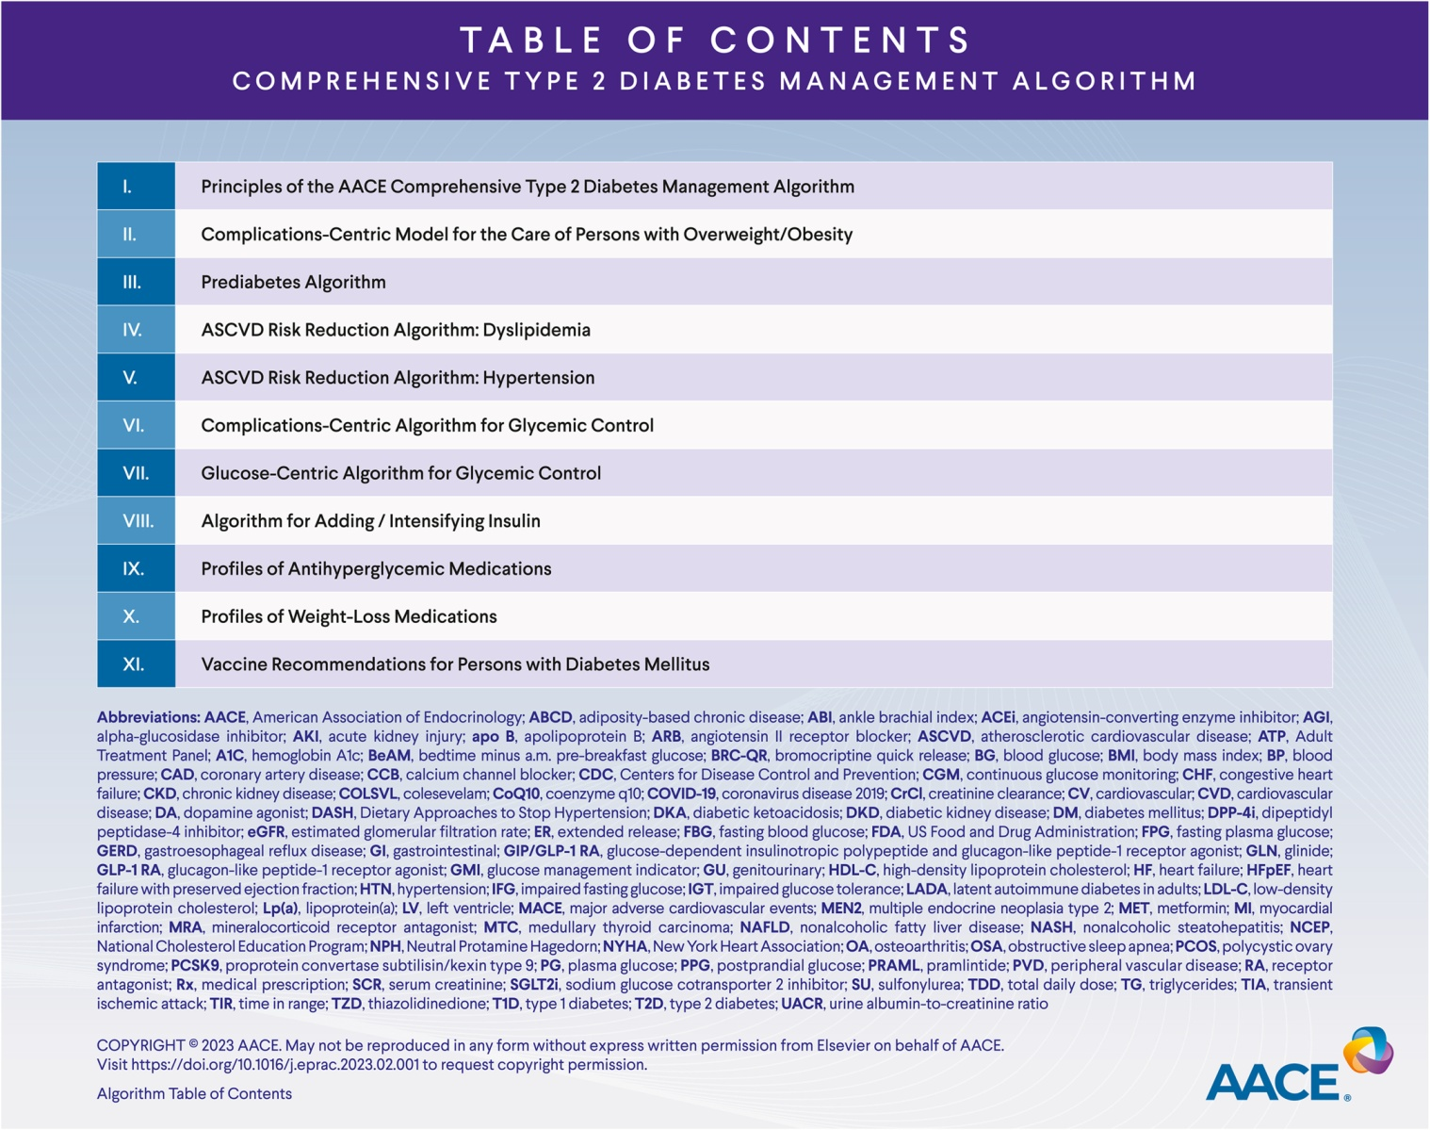
Endocrine Practice 2023 29305-340DOI: (10.1016/j.eprac.2023.02.001)
Copyright © 2023 AACE Terms and Conditions
Notes:
2023 AACE Type 2 Diabetes Algorithm Table of Contents. AACE = American Association of Endocrinology.

Slide 4
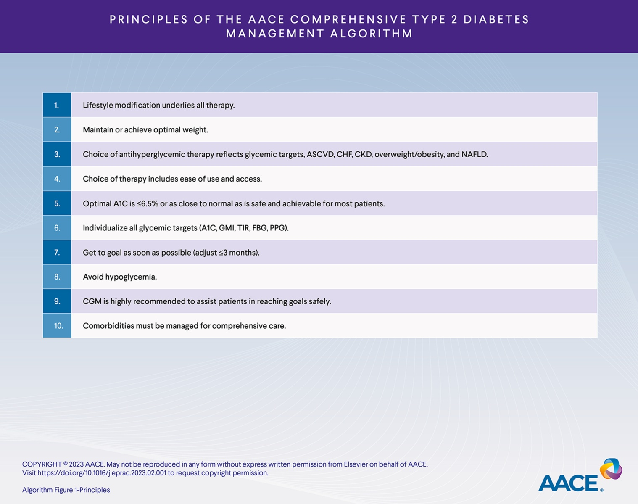
Endocrine Practice 2023 29305-340DOI: (10.1016/j.eprac.2023.02.001)
Copyright © 2023 AACE Terms and Conditions

Slide 5
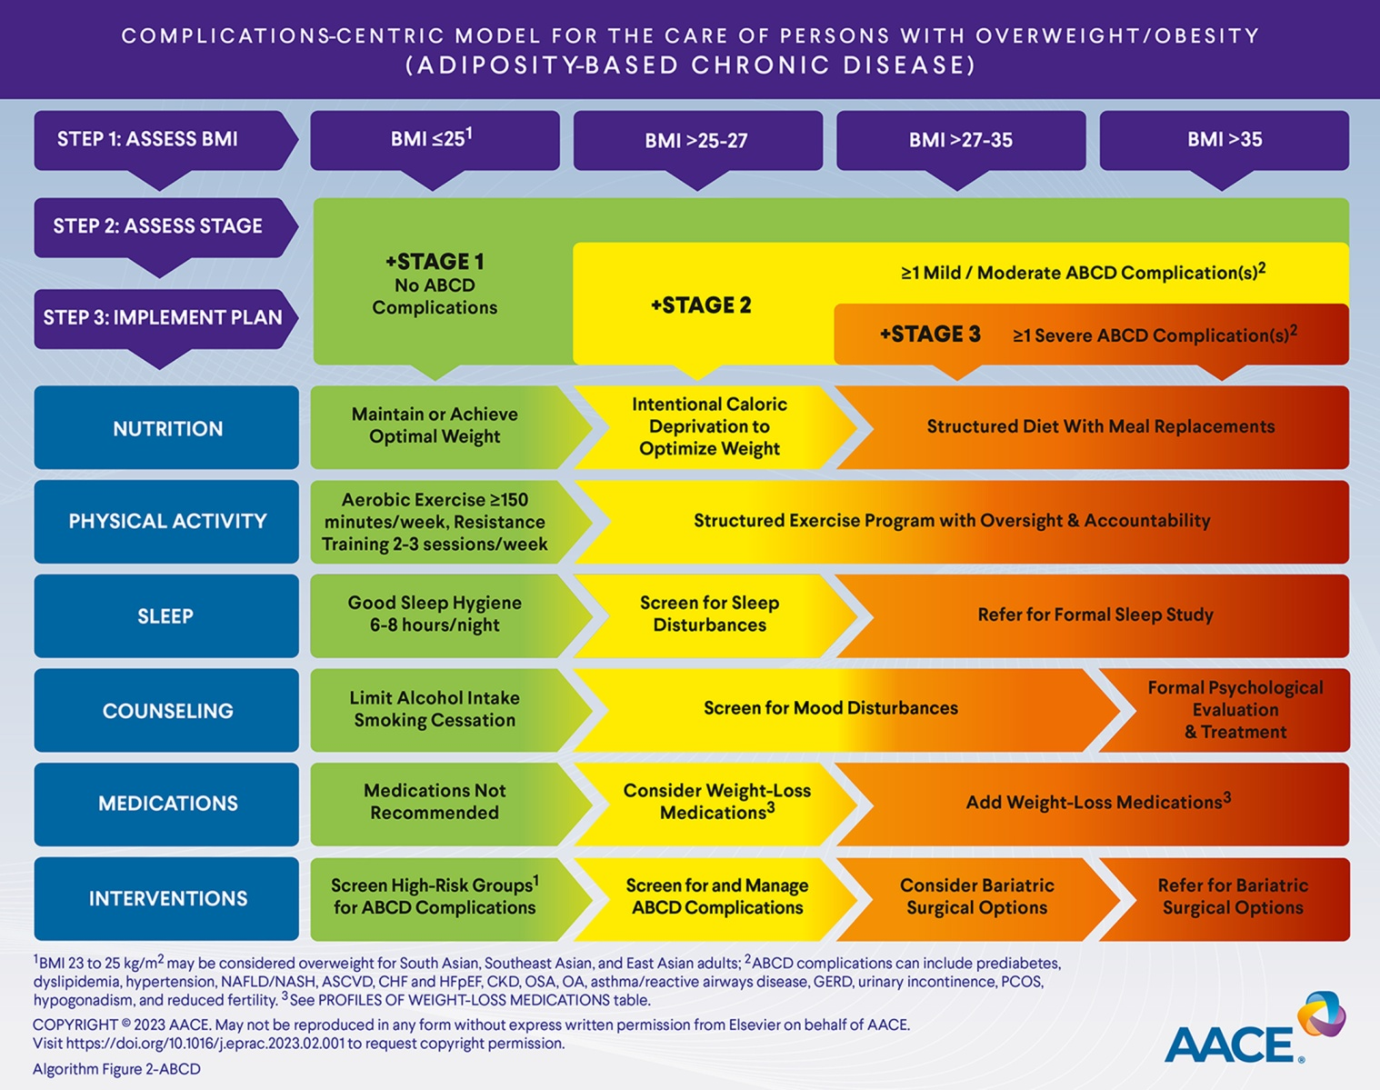
Endocrine Practice 2023 29305-340DOI: (10.1016/j.eprac.2023.02.001)
Copyright © 2023 AACE Terms and Conditions

Slide 6
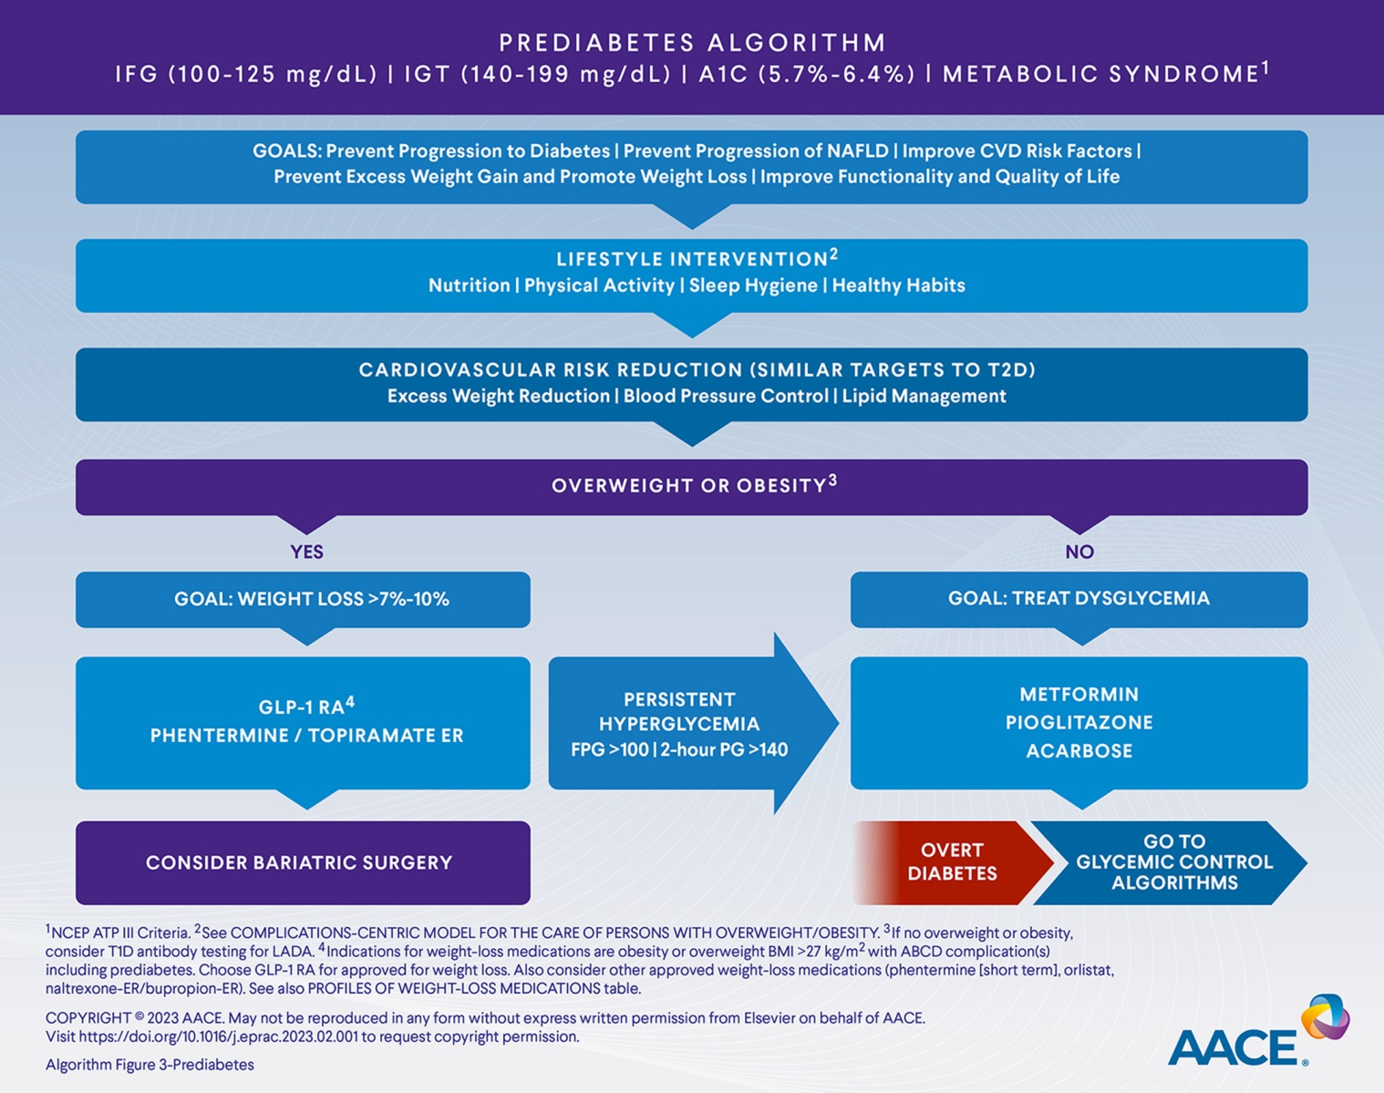
Endocrine Practice 2023 29305-340DOI: (10.1016/j.eprac.2023.02.001)
Copyright © 2023 AACE Terms and Conditions

Slide 7
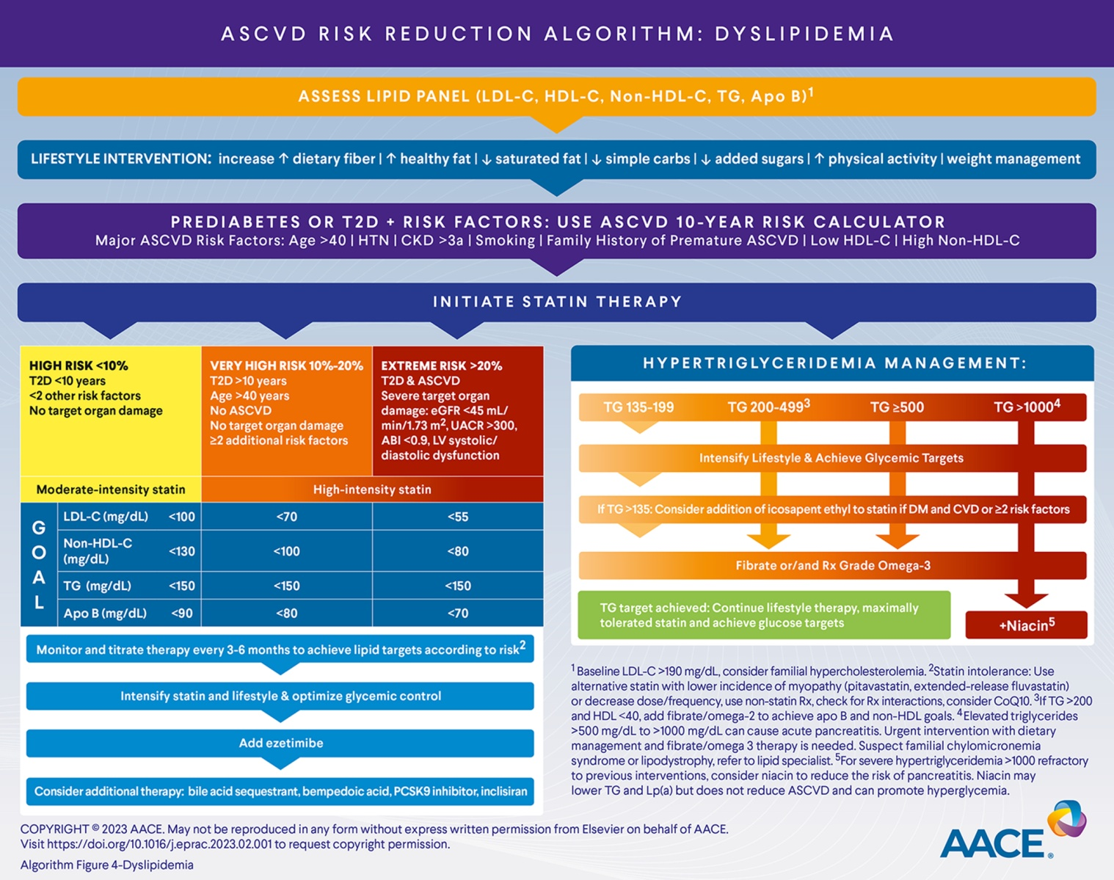
Endocrine Practice 2023 29305-340DOI: (10.1016/j.eprac.2023.02.001)
Copyright © 2023 AACE Terms and Conditions

Slide 8
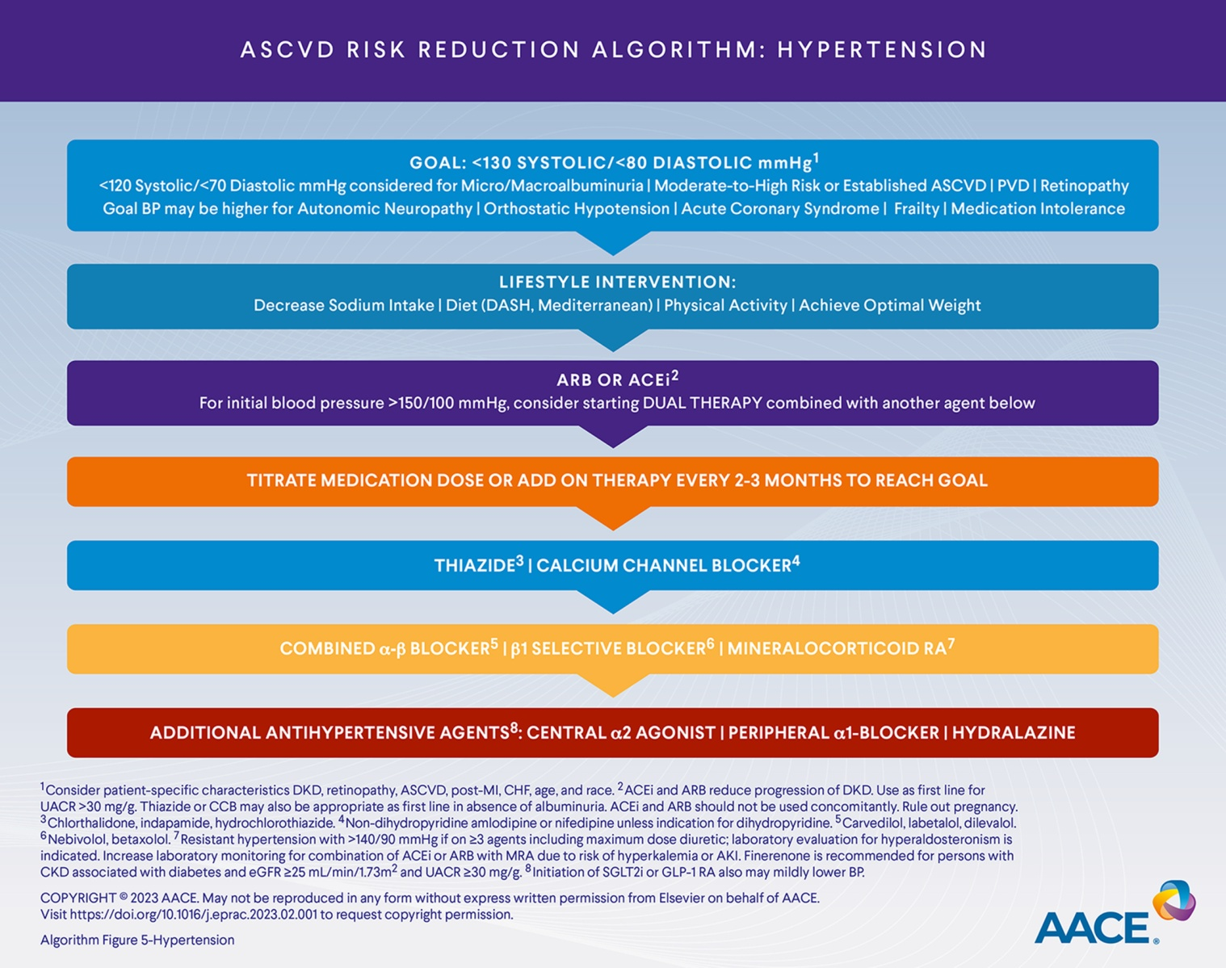
Endocrine Practice 2023 29305-340DOI: (10.1016/j.eprac.2023.02.001)
Copyright © 2023 AACE Terms and Conditions

Slide 9
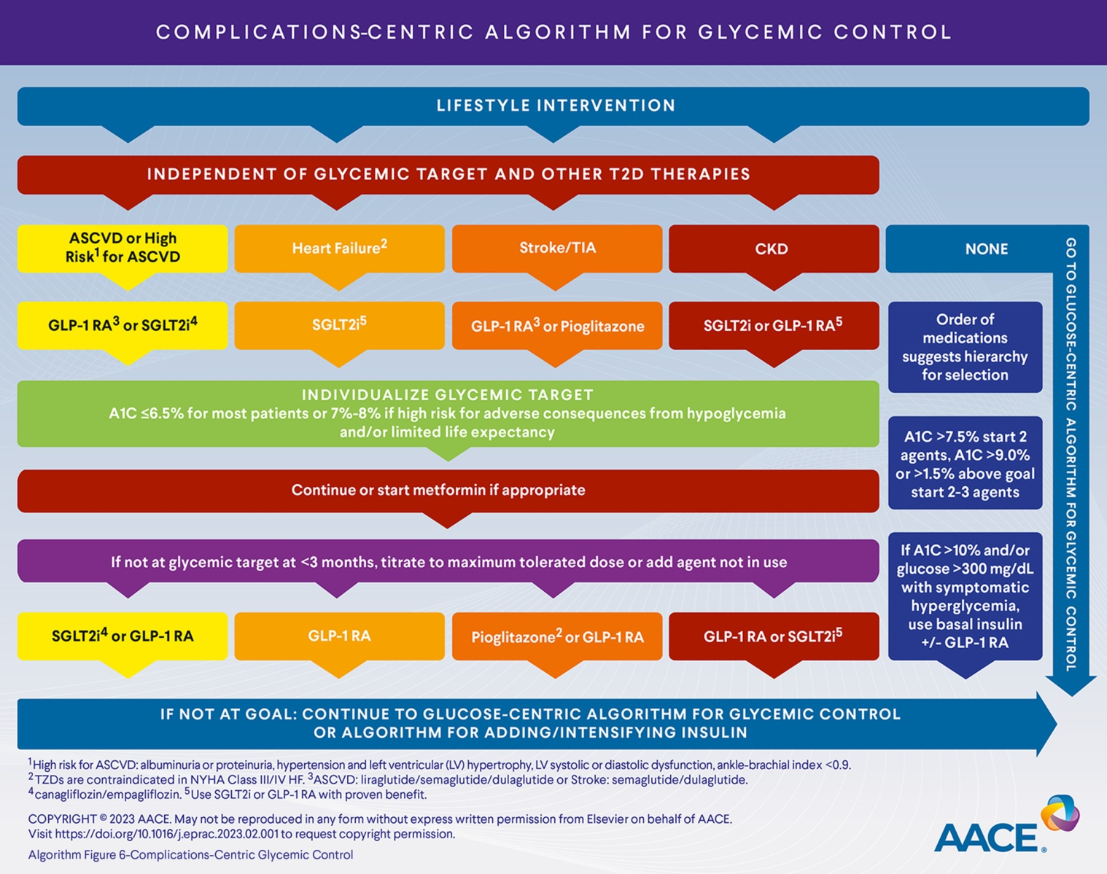
Endocrine Practice 2023 29305-340DOI: (10.1016/j.eprac.2023.02.001)
Copyright © 2023 AACE Terms and Conditions

Slide 10
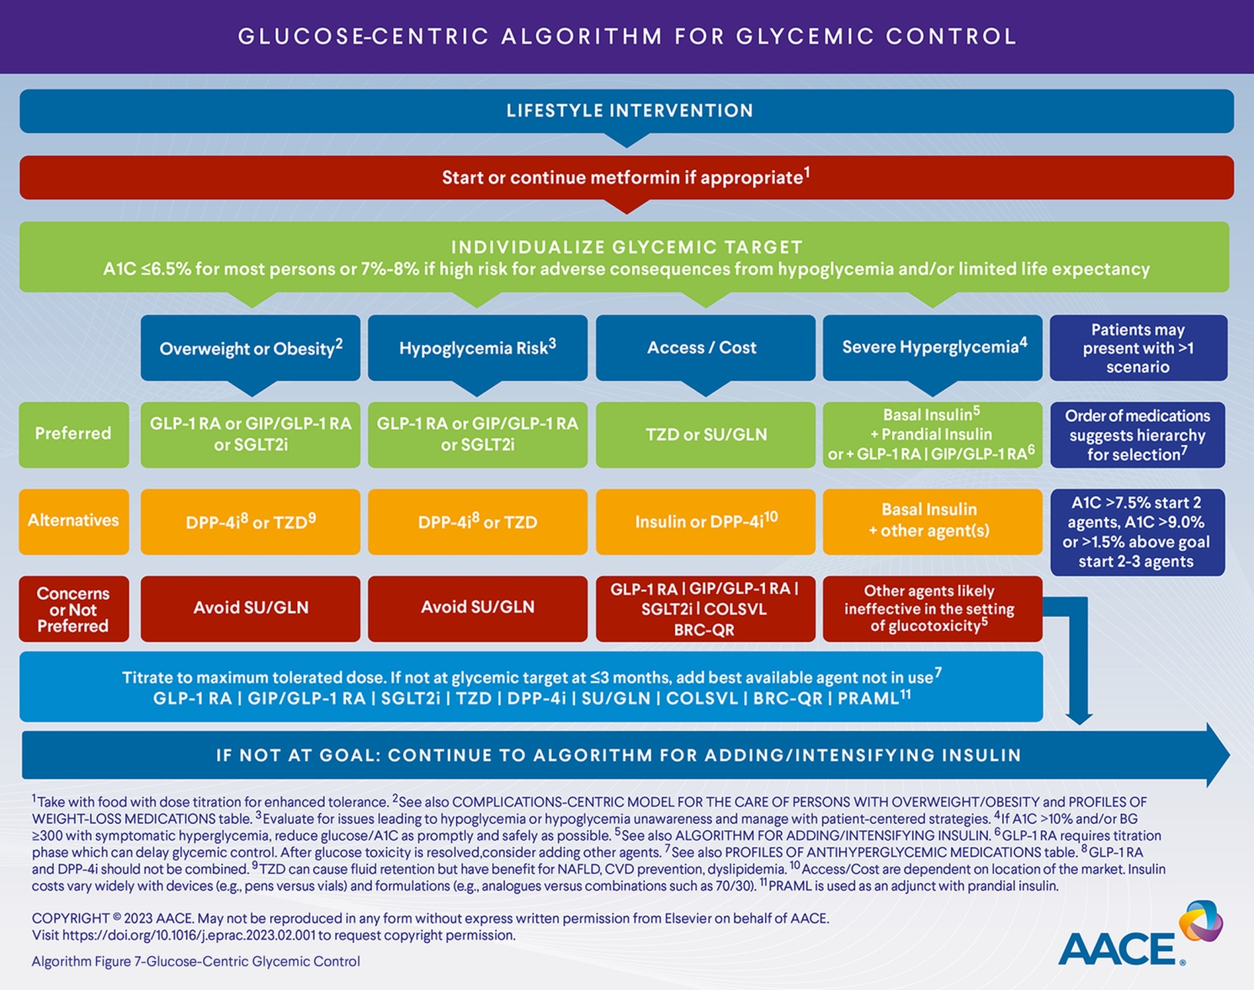
Endocrine Practice 2023 29305-340DOI: (10.1016/j.eprac.2023.02.001)
Copyright © 2023 AACE Terms and Conditions

Slide 11
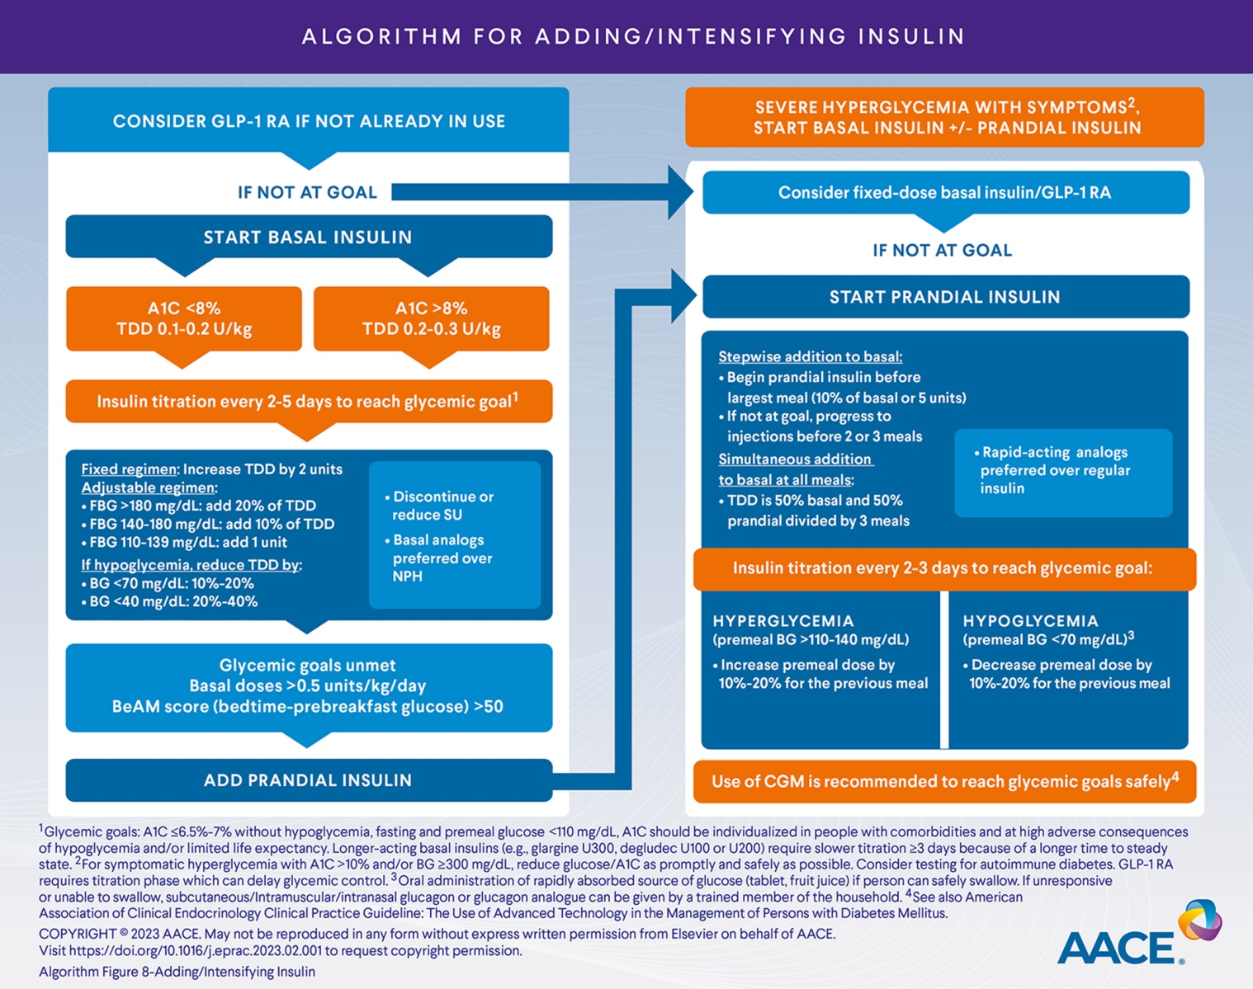
Endocrine Practice 2023 29305-340DOI: (10.1016/j.eprac.2023.02.001)
Copyright © 2023 AACE Terms and Conditions

Slide 12
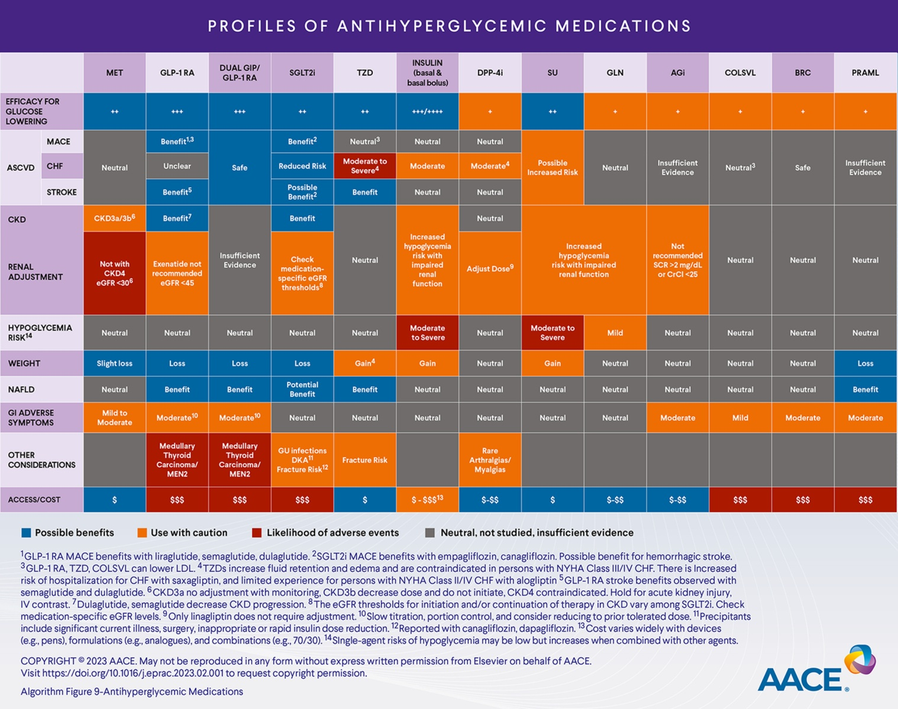
Endocrine Practice 2023 29305-340DOI: (10.1016/j.eprac.2023.02.001)
Copyright © 2023 AACE Terms and Conditions

Slide 13
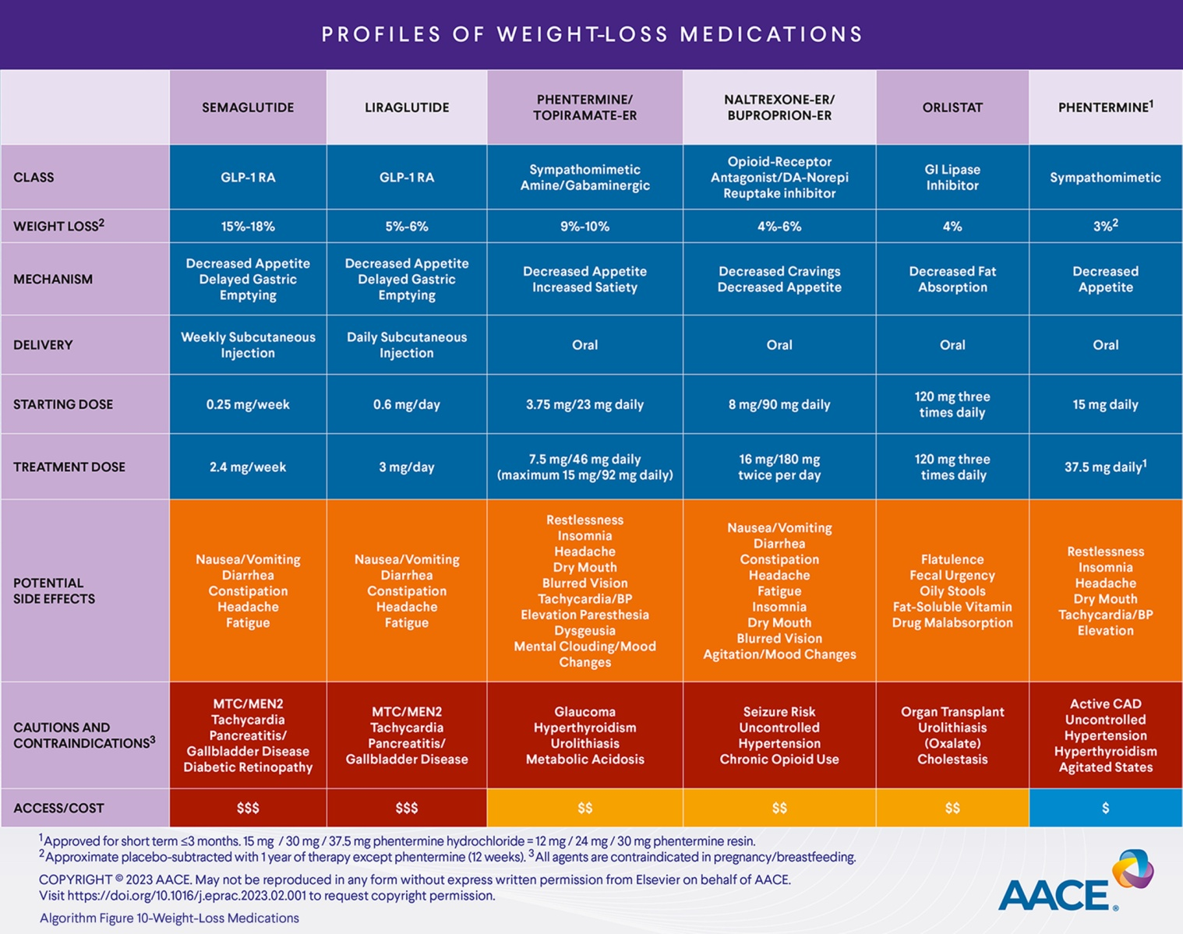
Endocrine Practice 2023 29305-340DOI: (10.1016/j.eprac.2023.02.001)
Copyright © 2023 AACE Terms and Conditions

Slide 14
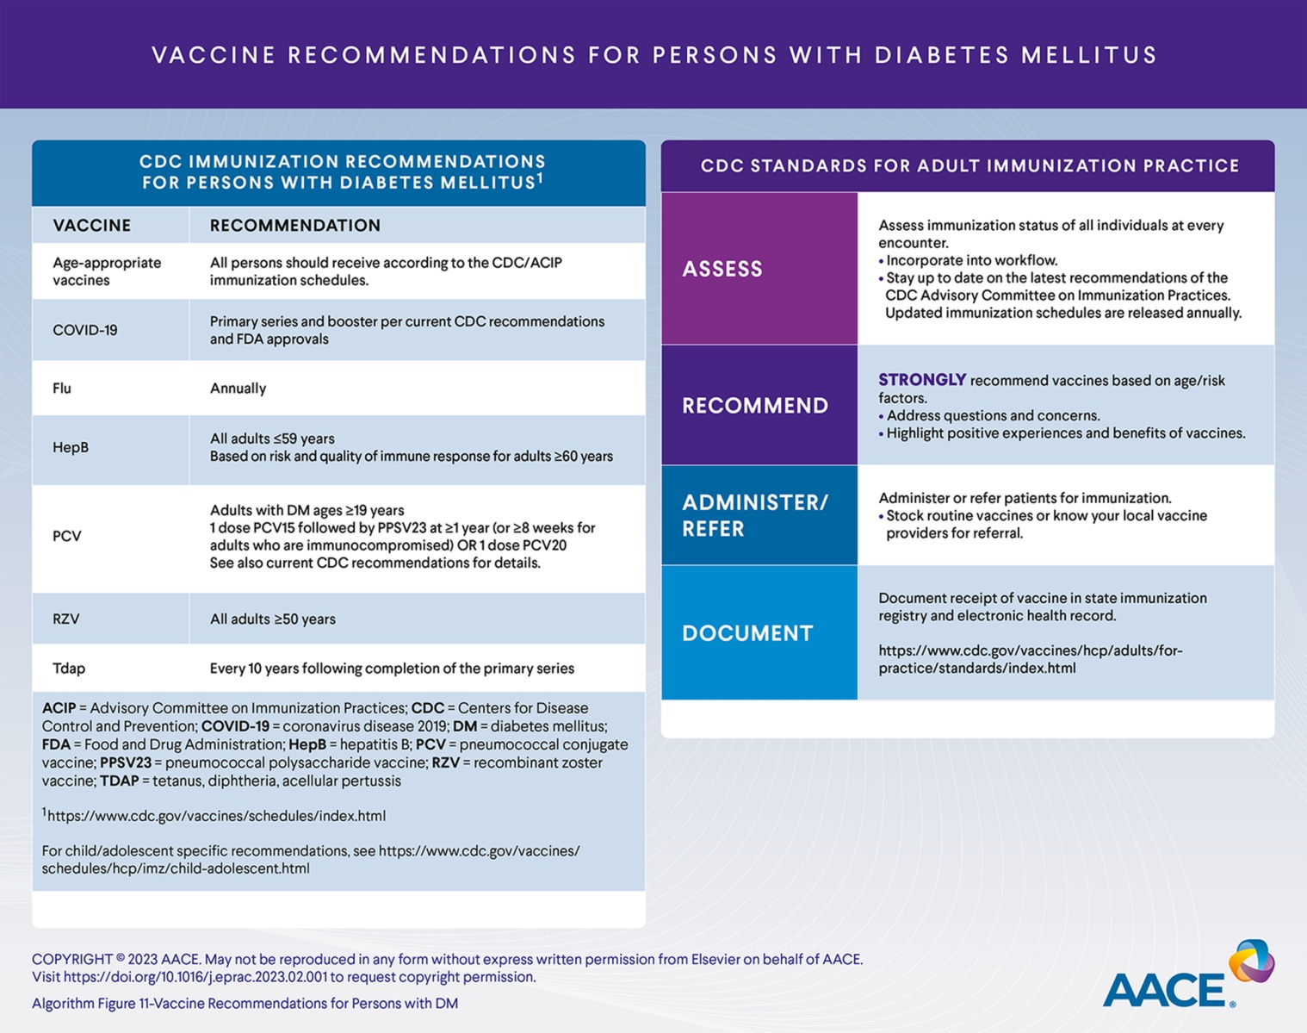
Endocrine Practice 2023 29305-340DOI: (10.1016/j.eprac.2023.02.001)
Copyright © 2023 AACE Terms and Conditions

Slide 15

Algorithm Fig. 1
Endocrine Practice 2023 29305-340DOI: (10.1016/j.eprac.2023.02.001)
Copyright © 2023 AACE Terms and Conditions
Notes:
Principles of the AACE Comprehensive Type 2 Diabetes Management Algorithm. AACE = American Association of Endocrinology.

Slide 16
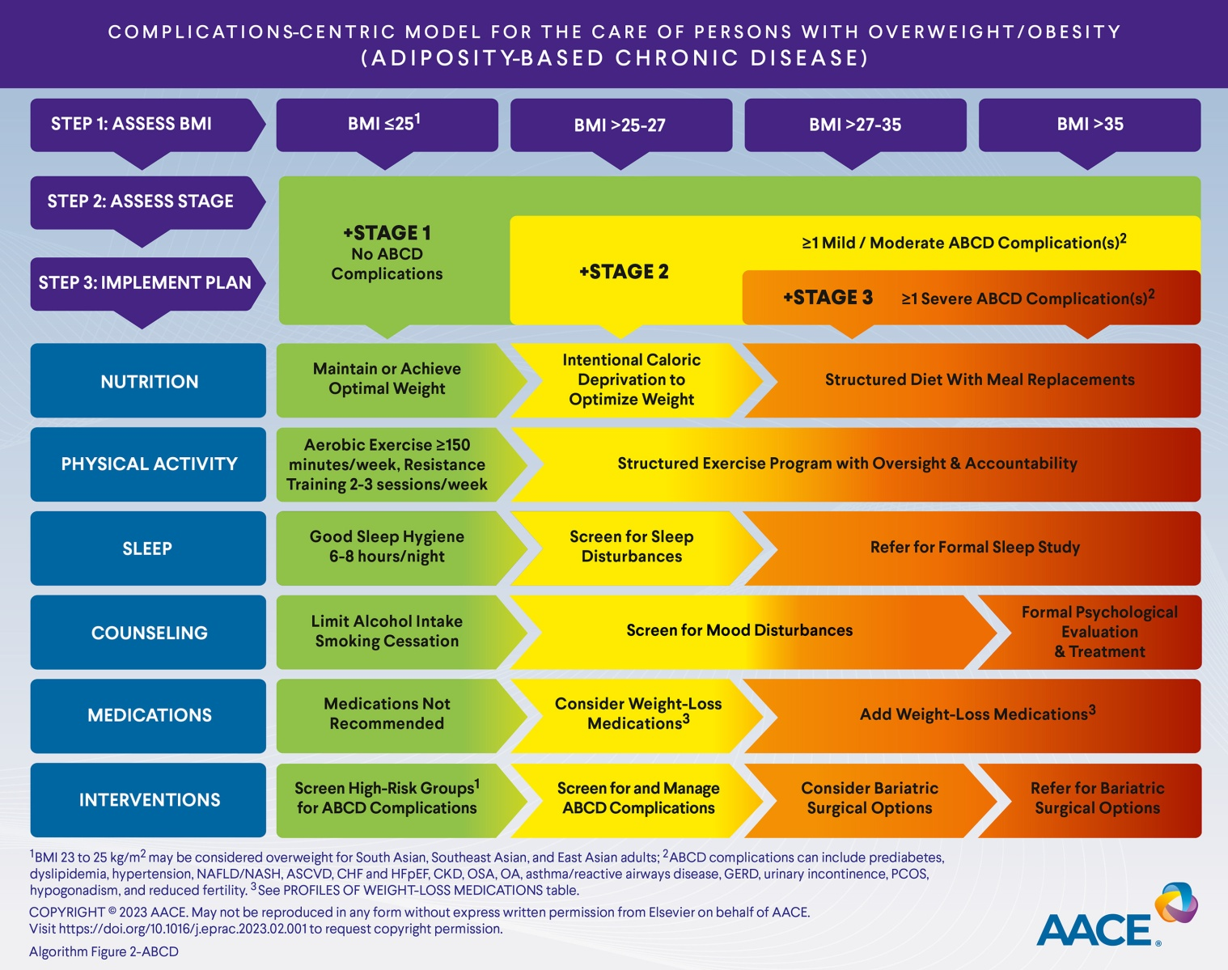
Algorithm Fig. 2
Endocrine Practice 2023 29305-340DOI: (10.1016/j.eprac.2023.02.001)
Copyright © 2023 AACE Terms and Conditions
Notes:
Complications-Centric Model for the Care of Persons with Overweight/Obesity (Adiposity-Based Chronic Disease).

Slide 17

Algorithm Fig. 3
Endocrine Practice 2023 29305-340DOI: (10.1016/j.eprac.2023.02.001)
Copyright © 2023 AACE Terms and Conditions
Notes:
Prediabetes Algorithm.

Slide 18

Algorithm Fig. 4
Endocrine Practice 2023 29305-340DOI: (10.1016/j.eprac.2023.02.001)
Copyright © 2023 AACE Terms and Conditions
Notes:
Atherosclerotic Cardiovascular Disease Risk Reduction Algorithm: Dyslipidemia.

Slide 19
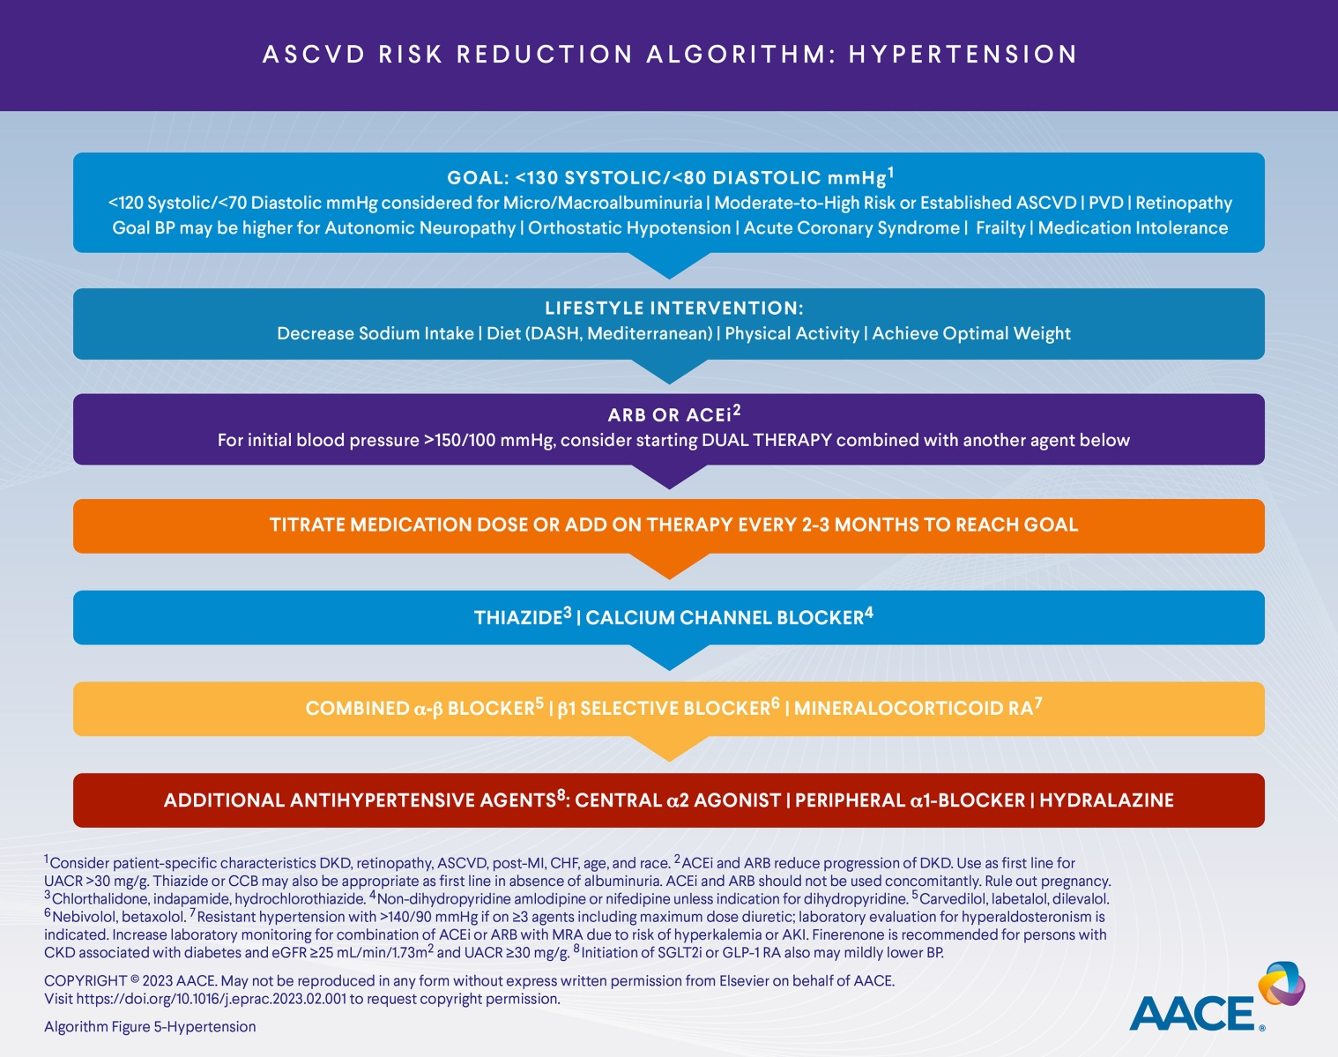
Algorithm Fig. 5
Endocrine Practice 2023 29305-340DOI: (10.1016/j.eprac.2023.02.001)
Copyright © 2023 AACE Terms and Conditions
Notes:
Atherosclerotic Cardiovascular Disease Risk Reduction Algorithm: Hypertension.

Slide 20

Algorithm Fig. 6
Endocrine Practice 2023 29305-340DOI: (10.1016/j.eprac.2023.02.001)
Copyright © 2023 AACE Terms and Conditions
Notes:
Complications-Centric Algorithm for Glycemic Control.

Slide 21

Algorithm Fig. 7
Endocrine Practice 2023 29305-340DOI: (10.1016/j.eprac.2023.02.001)
Copyright © 2023 AACE Terms and Conditions
Notes:
Glucose-Centric Algorithm for Glycemic Control.

Slide 22

Algorithm Fig. 8
Endocrine Practice 2023 29305-340DOI: (10.1016/j.eprac.2023.02.001)
Copyright © 2023 AACE Terms and Conditions
Notes:
Algorithm for Adding/Intensifying Insulin.

Slide 23

Algorithm Fig. 9
Endocrine Practice 2023 29305-340DOI: (10.1016/j.eprac.2023.02.001)
Copyright © 2023 AACE Terms and Conditions
Notes:
Profiles of Antihyperglycemic Medications.

Slide 24

Algorithm Fig. 10
Endocrine Practice 2023 29305-340DOI: (10.1016/j.eprac.2023.02.001)
Copyright © 2023 AACE Terms and Conditions
Notes:
Profiles of Weight-Loss Medications.

Slide 25

Algorithm Fig. 11
Endocrine Practice 2023 29305-340DOI: (10.1016/j.eprac.2023.02.001)
Copyright © 2023 AACE Terms and Conditions
Notes:
Vaccine Recommendations for Persons with Diabetes Mellitus.

